Slide 1
Transition Gawler
Presentation to NRC AGM
27th November 2012

Slide 2
Who are we?
Who are we?
What is Transition?
Where did it Start?
What were the driving forces?
What does it look like?
Benefits of Transition?
Transition in Gawler
What we have done?
What we hope to do?
How can we work together
Leigh Dalwood
Kathryn Warhurst
Liz Ninnes
Jill Young
Mark Clayton
With support from GLF CAP;
Genevieve Harris
Wendy Keetch
Nigel Laiety
Christina Colero
Gail Fairlamb
Wendy Foster

Slide 3
What is Transition?
Who are we?
What is Transition?
Where did it Start?
What were the driving forces?
What does it look like?
Benefits of Transition?
Transition in Gawler
What we have done?
What we hope to do?
How can we work together
Positive, solutions-focused, community-scale response to the social impacts of peak oil and climate change by,
Building local resilience through collective action rather than government reform or individual action
Notes:
Dealing with these problems together

Slide 4
What is Transition?
Who are we?
What is Transition?
Where did it Start?
What were the driving forces?
What does it look like?
Benefits of Transition?
Transition in Gawler
What we have done?
What we hope to do?
How can we work together
“If we wait for governments, it’ll be too little too late. If we act as individuals, it’ll be too little. But if we act as communities, it might just be enough, just in time”.
Rob Hopkins (Co-founder Transition Network)

Slide 5

Where did it start?
Who are we?
What is Transition?
Where did it Start?
What were the driving forces?
What does it look like?
Benefits of Transition?
Transition in Gawler
What we have done?
What we hope to do?
How can we work together
Rob Hopkins – Permaculture
Transition Town Totnes
Transition Network
Many hundreds of official Transition sites
Over 1800 sites globally ‘Mulling’

Slide 6
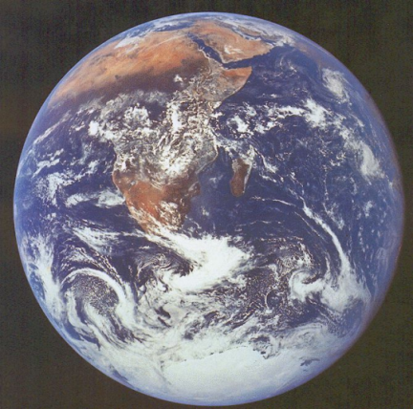
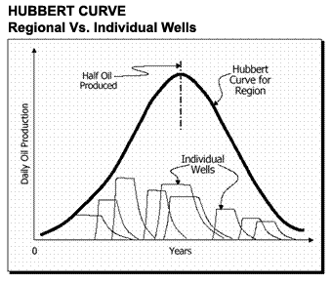
What were the driving forces?
Who are we?
What is Transition?
Where did it Start?
What were the driving forces?
What does it look like?
Benefits of Transition?
Transition in Gawler
What we have done?
What we hope to do?
How can we work together
Climate Change
Peak Oil
struggling local economy
Lack of local employment
opportunities

Slide 7
What might Transition look like?
Who are we?
What is Transition?
Where did it Start?
What were the driving forces?
What does it look like?
Benefits of Transition?
Transition in Gawler
What we have done?
What we hope to do?
How can we work together
Community projects
Small and large
Themes
Food
Transport
Energy
Economy
Arts and Culture
Waste
Biodiversity

Slide 8
What might Transition look like?
Who are we?
What is Transition?
Where did it Start?
What were the driving forces?
What does it look like?
Benefits of Transition?
Transition in Gawler
What we have done?
What we hope to do?
How can we work together
food miles reduced
more bikes less cars
more businesses owned by local people
more community employed locally
sustainable resource use
And many, many other things to..

Slide 9
Benefits of a Transition approach
Who are we?
What is Transition?
Where did it Start?
What were the driving forces?
What does it look like?
Benefits of Transition?
Transition in Gawler
What we have done?
What we hope to do?
How can we work together
Deal with peak oil and climate change in a positive way
Community cohesion – reaches out to everybody
Notes:
Positive
Constructive
Grass-roots
Independant of Government
And government policies

Slide 10
Transition in Gawler
Who are we?
What is Transition?
Where did it Start?
What were the driving forces?
What does it look like?
Benefits of Transition?
Transition in Gawler
What we have done?
What we hope to do?
How can we work together
Transport Arts and Culture
Food Waste
Energy Economy
Making best use of what we have got
and the opportunities on offer
to normalise new behaviours

Slide 11
What have we done?
Who are we?
What is Transition?
Where did it Start?
What were the driving forces?
What does it look like?
Benefits of Transition?
Transition in Gawler
What we have done?
What we hope to do?
How can we work together
Steering Group creation and membership
Governance and organisational framework (Charter)
Visioning
Research Transition
Raising awareness
Web page

Slide 12
What we hope to do
Who are we?
What is Transition?
Where did it Start?
What were the driving forces?
What does it look like?
Benefits of Transition?
Transition in Gawler
What we have done?
What we hope to do?
How can we work together
Build our capacity as a steering committee
Raise awareness further and connect with stakeholders
‘Unleashing’ of ‘Transition Gawler’ in November 2013 (maybe)
Establish ‘Themes’ groups in the community

Slide 13
How can we work together?
Who are we?
What is Transition?
Where did it Start?
What were the driving forces?
What does it look like?
Benefits of Transition?
Transition in Gawler
What we have done?
What we hope to do?
How can we work together?
Where does NRC and Transition Gawler overlap and complement each other?

